Slide 1


Pune Vidyarthi Griha’s College of Engineering &Technology and G K Pate (Wani ) Institute of Management Pune-09 Department of Information Technology
College Logo
Seminar Presentation
On
Design and Implementation of Smart Contract in Supply Chain Management Using Blockchain and Internet of Things
By
3051-Sagar Prakash Giradkar
Guide
Prof.S.G.Kamble
Day and Date of Exam : Saturday 14/10/2023

Slide 2
Contents
Aim & Objectives
Introduction
Literature Survey
Background of Blockchain
System Model
Software Components
System Design
Implementation Results
Applications/advantages
Conclusions
References

Slide 3
Aim and Objective of Seminar
Aim of the Seminar:
Integration of blockchain and Internet of Things (IoT) in supply chain management.
Objective of the Seminar:
To Introduce Supply Chain Management
To Explain Blockchain Technology
To Highlight the Role of IoT in Supply Chains
To Explore Integration Benefits
To Showcase Use Cases and Implementations
To Discuss Future Trends and Opportunities

Slide 4
Introduction
Supply Chain Management (SCM) has tremendous impact on global economy in today’s market .
The transfer of goods from producer to consumer is called SCM.
It involeves the manufactures ,distributor,and retailes and they do the illigal activites , by changing the actual records of the goods and not maintain the papers of the transaction .
Blockchain and IoT revolutionizes SCM, offering immutability, security, and real-time data insights to manage the records of transactions.
Blockchain acts as an immutable digital ledger, while IoT interconnects devices for real-time data collection.
The synergy of Blockchain and IoT holds immense potential, enhancing traceability, reducing errors, and boosting operational efficiency in SCM.

Slide 5
Literature Survey/Related work
Title | Authors | Publish Year | Summary | Problems found
Design and Implementation of Smart Contract in Supply Chain Management Using Blockchain and Internet of Things | Fatima Naqvi , Sundus Haseeb , , Namra Khan | April 2023 | The paper presents a blockchain-based approach using smart contracts and IoT for reliable supply chain management, focusing on monitoring shipping conditions and automating interactions between stakeholders to ensure compliance with predefined requirements.
Emergence of Blockchain-based IoT Marketplaces | Saputhanthri, A.; Alwis, C.D.; Liyanage, M. | June 2021 | Explores the rise of Blockchain-based IoT marketplaces and their potential impact on various industries.
Minimum FIVE references should be there from literature.

Slide 6
Literature Survey/Related work
Title | Authors | Publish Year | Summary | Problems found
Ethereum Smart Contract Analysis Tools: A Systematic Review | SATPAL SINGH KUSHWAH ,SANEEP JOSHI , DILBAG SINGH , MANJIT KAUR | April 22, 2022, | This paper reviews 86 Ethereum smart contract analysis tools, categorizing them into static and dynamic approaches, identifying re-entrancy as a common vulnerability, and emphasizing the effectiveness of hybrid analysis in detecting over 95% of security flaws, while outlining future challenges and recommendations.
Blockchain Platform For COVID-19 Vaccine Supply Management | Antal, C.; Cioara, T.; Antal, M.; Anghel, I. | IEEE Open Journal of Computer Society, 2021 | Proposes a Blockchain platform for efficient COVID-19 vaccine supply management.
Minimum FIVE references should be there from literature.

Slide 7
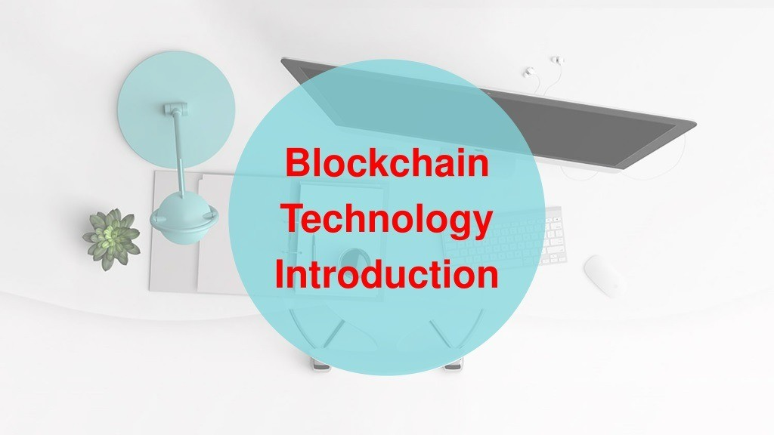

Slide 8
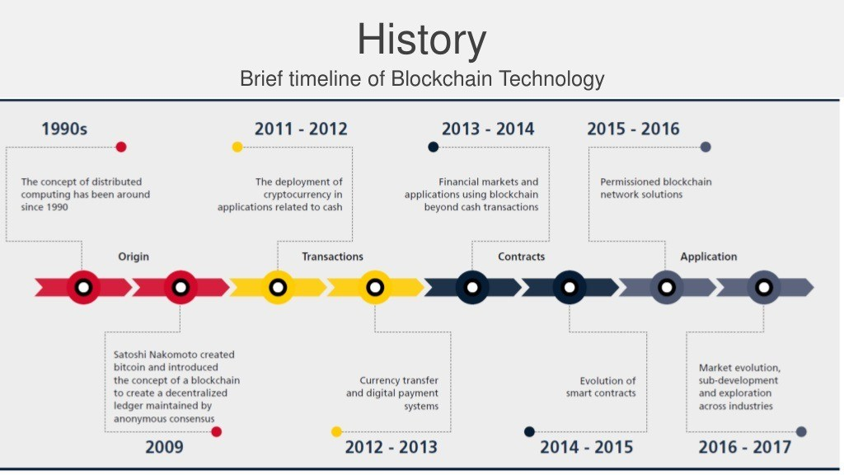

Slide 9
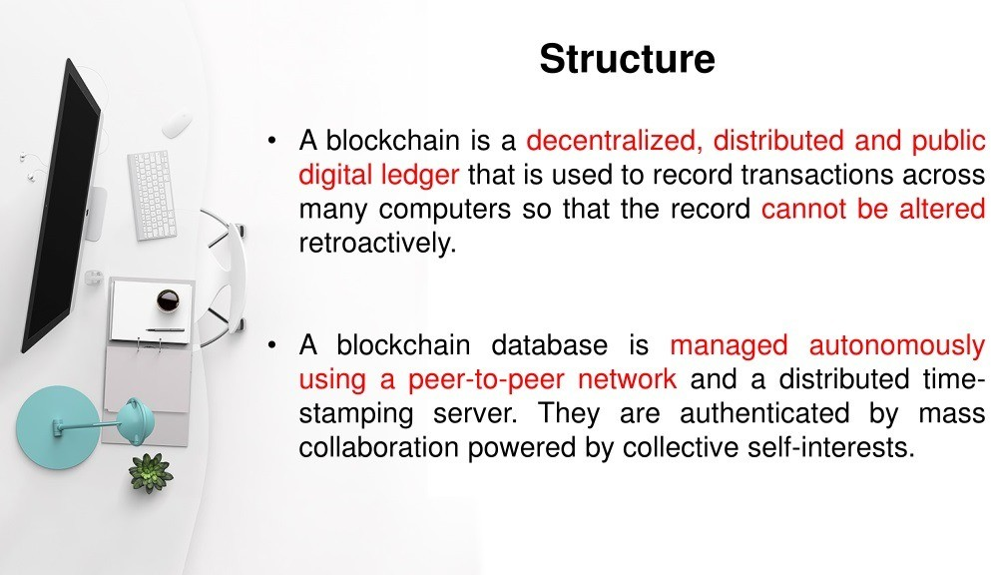

Slide 10
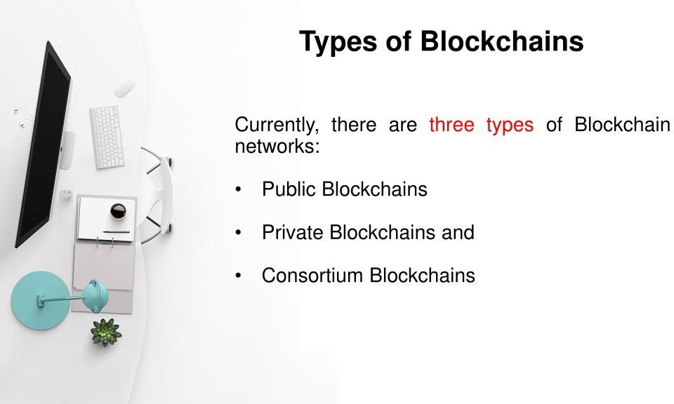

Slide 11
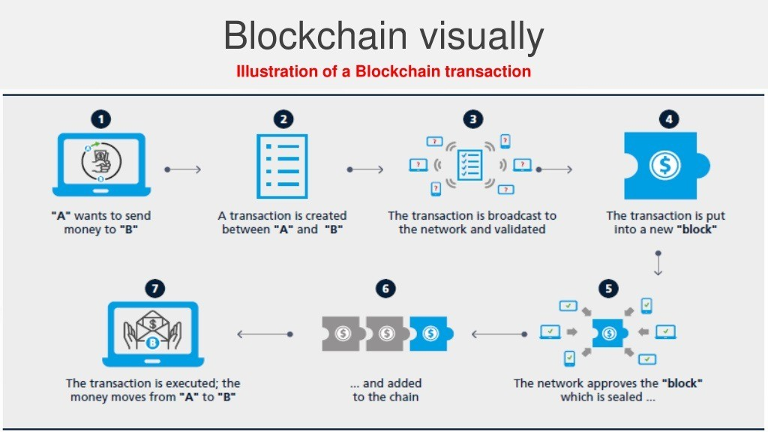

Slide 12
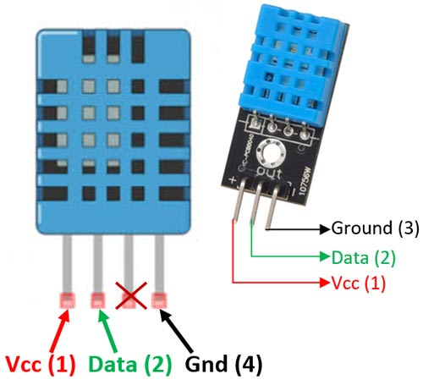
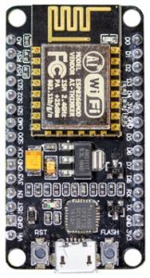
System Model and Software Components
Software Components
MetaMask
EtherScan
Remix IDE
Firebase
Arduino IDE
DHT11 sensor
NodeMCU ESP8266

Slide 13
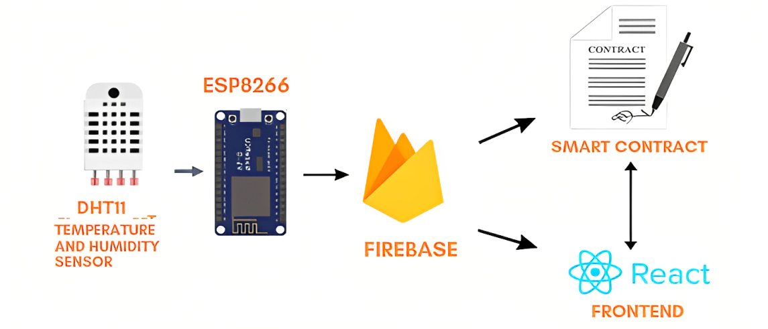
System Design
End-to-end system diagram.

Slide 14
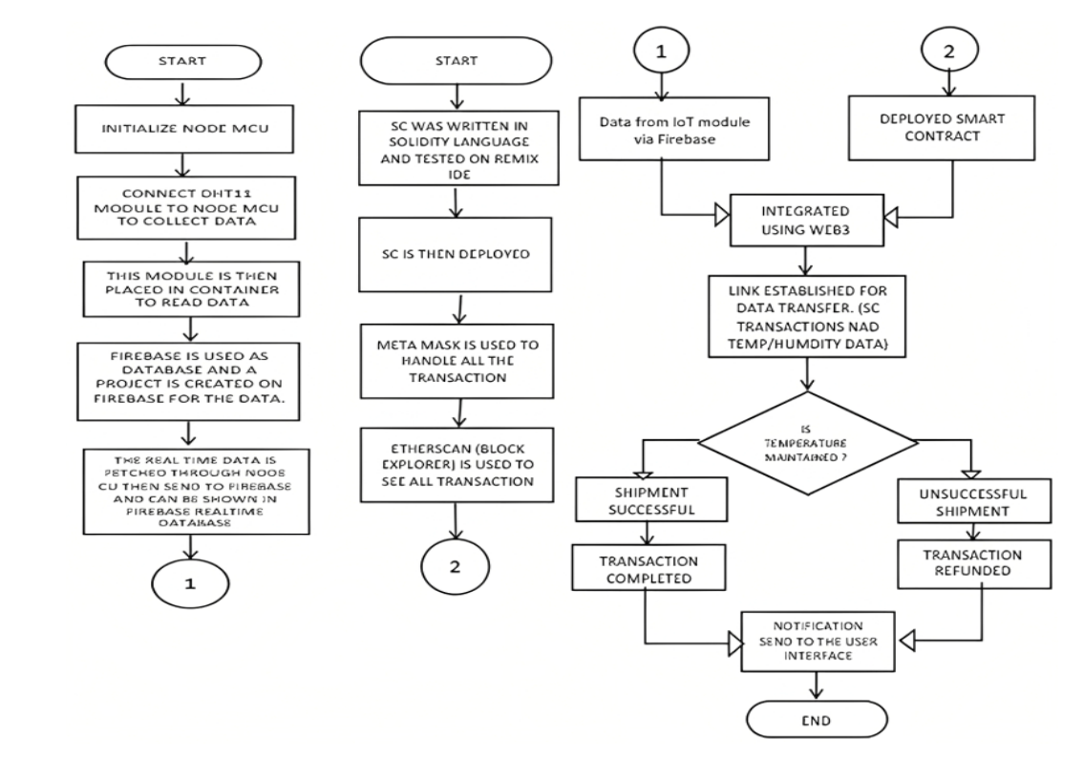
System Design
System design flowchart

Slide 15
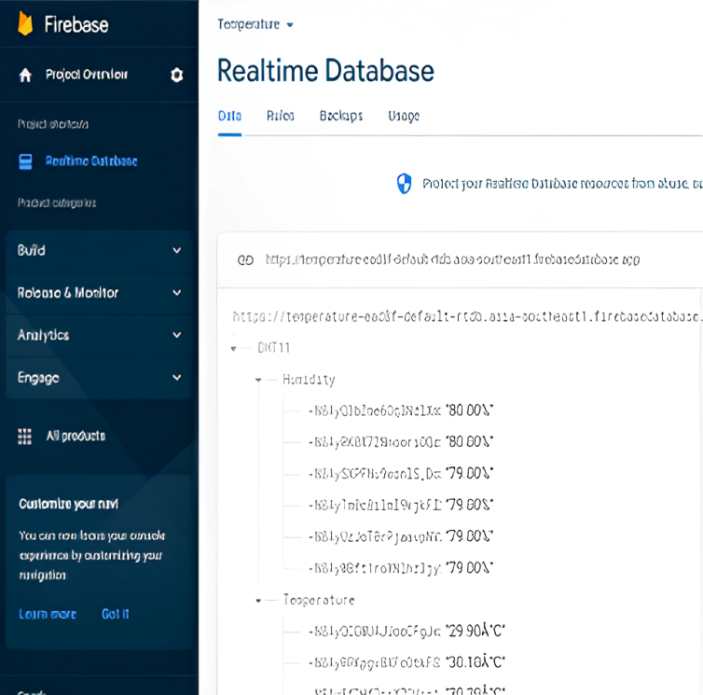
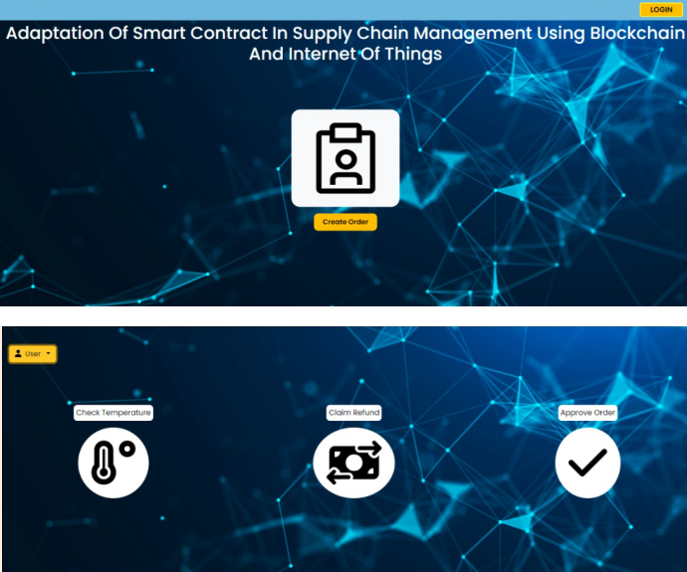
Implementation Results
A] Collected data stored in FireBase database
B] User-Interface

Slide 16

Video of SCM

Slide 17
Advantages
Automation and Efficiency
Transparency and Traceability
Security and Trust
Reduced Costs
Real-time Monitoring

Slide 18
Disadvantages
Complexity
Scalability Challenges
Cost of Implementation
Privacy Concerns
Dependency on Technology
Legal and Regulatory Challenges

Slide 19
Applications
Automated Transactions and Payments
Real-time Monitoring and Transparency
Quality Control and Compliance
Efficient Inventory Management
Enhanced Security and Fraud Prevention
Supply Chain Traceability and Provenance
Streamlined Dispute Resolution
Cost Reduction and Efficiency

Slide 20
Conclusions
In this seminar, we delved into integrating smart contracts, blockchain, and IoT for streamlined supply chain management using hardware like NodeMCU and DHT11 sensors.
The study highlighted the transformative potential of this integration, enabling automated, secure, and transparent interactions through Solidity-based smart contracts and real-time IoT data.
Inspired by the seminar, I aim to implement and advance this integrated approach in my final year project, aiming to optimize supply chain management with newfound knowledge and enthusiasm.

Slide 21
References
[1]Saputhanthri, A.; Alwis, C.D.; Liyanage, M. Emergence of Blockchain based IoT Marketplaces. In Proceedings of the Joint European Conference on Networks and Communications (EuCNC) & 6G Summit, Porto, Portugal, 8–11 June 2021.
[2]Wang, Z.; Jin, H.; Dai, W.; Choo, K.K.; Zou, D. Ethereum smart contract security research: Survey and future research opportunities.Front. Comput. Sci. 2021, 15, 152802. [CrossRef]
[3]Reyna, A.; Martín, C.; Chen, J.; Soler, E.; Díaz, M. On blockchain and its integration with IoT. Challenges and opportunities.Future Gener. Comput. Syst. 2018, 88, 173–190. [CrossRef]
[4]Anbunathan, R. Smart Home Solution Using Smart Contract. 2022. Available online: https://www.electronicsforu.com/electronics-projects/hardware-diy/smart-home-solution-using-smart-contract (accessed on 31 December 2022).
[5]Goda, M.P. Blockchain Enabled Vaccine Supply Chain Provenance. Master’s Thesis, The Pennsylvania State University, StateCollege, PA, USA, 2021.

Slide 22
Thank You
Question & Answer

